Slide 1
Minors Employed in U.S. Agriculture: A Need for Data
Matthew Rowen
Project Course 2017

Slide 2
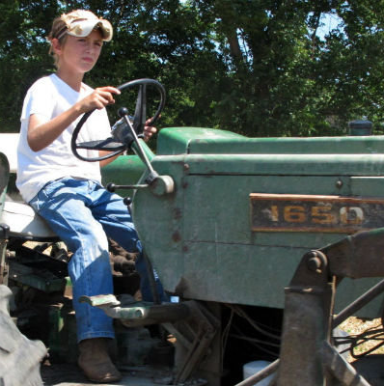
Research Questions
1. To what extent are minors employed in agricultural work in the U.S.?
  What data exists on the trends, numbers, and characteristics of agriculturally employed minors, including those on tobacco farms?
  Data gaps?
2. What is known about the well-being of minors employed in hazardous and non-hazardous agricultural work in the U.S.?
  What data exists on the safety and health of agriculturally employed minors?
  Data gaps ?
Mercer, Marsha. 2013. “Children as Young as 10 Can do Farm Work in Some States.” Pew Charitable Trusts. http://www.pewtrusts.org/en/research-and-analysis/blogs/stateline/2013/08/30/children-as-young-as-10-can-do-farm-work-in-some-states.

Slide 3
Purpose of Study
 | Non-Agricultural Employment | Agricultural Employment
Min. Age: Non-Hazardous Occupations | 14 | 14
 |  | 10 with parental consent
Min. Age: Hazardous Occupations | 18 | 16
Minimum Wage and Overtime | $7.25/hr YM: $4.25/hr OT: 1.5 x wage | $7.25/hr (exceptions) OT: N/A
Maximum Working Hours: Ages < 16 | School hours: 0 In session: 3hrs/day, 18hrs/week Not in session: 8hrs/day, 40hrs/week | School hours: 0
Disparities between agricultural and non-agricultural child labor laws
  Particularly for hazardous occupations
Numerous past legislative efforts to change laws have failed
Congress showing renewed interest in the topic
Lack of complete understanding of size, scope, and severity of the problem
  A need to know what data exists on agriculturally employed youth, and where there may be gaps in the data

Slide 4



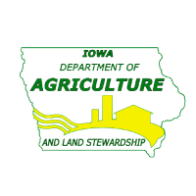



Methodology
Search for federal-level data
  CDC
  Census Bureau
  USDOL
  OSHA
  EPA
Search for state-level data
  Departments of Labor and Agriculture (or equivalents)
    California
    Texas
    Iowa
    North Carolina
Search for non-governmental data
Interviews with field experts
  Federal, state, non-governmental

Slide 5
Findings
Demographics & Hazardous Occupations

Slide 6
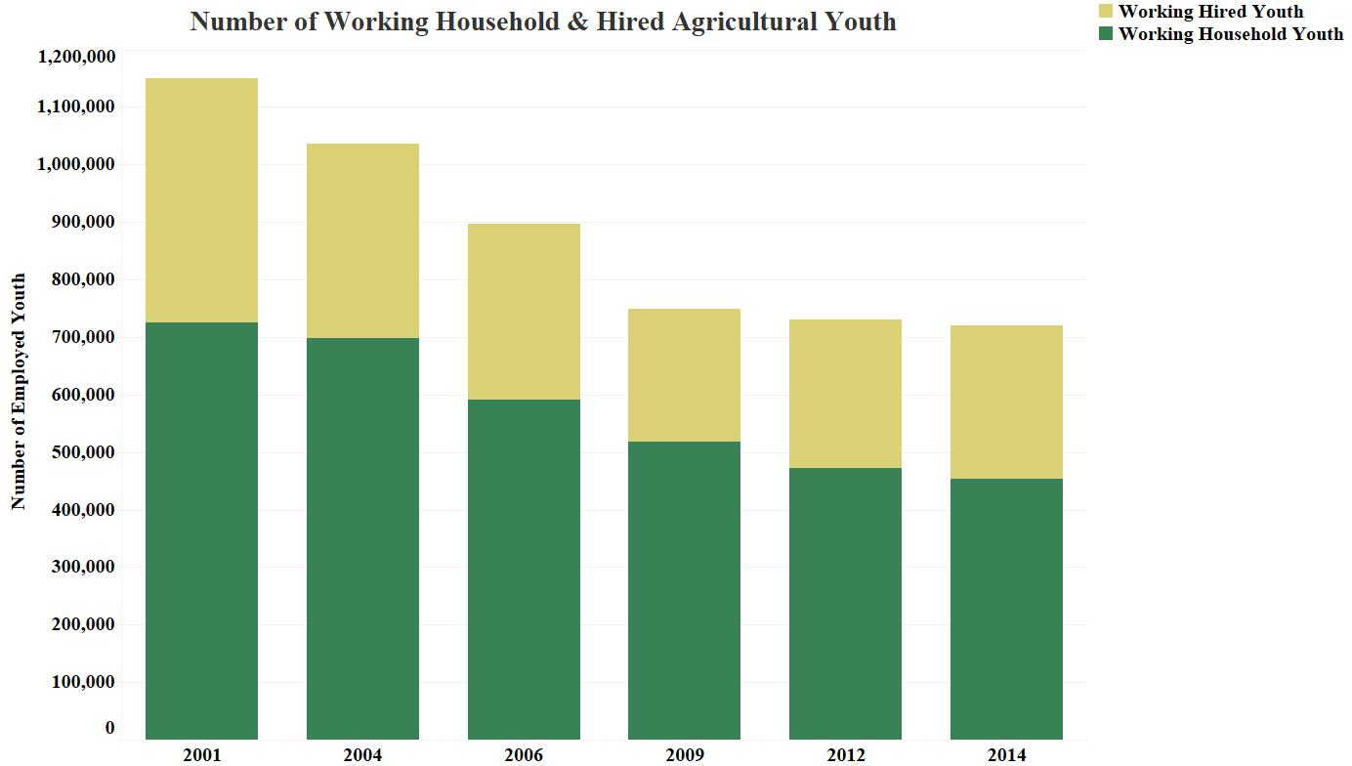
Totals & Trends

Slide 7
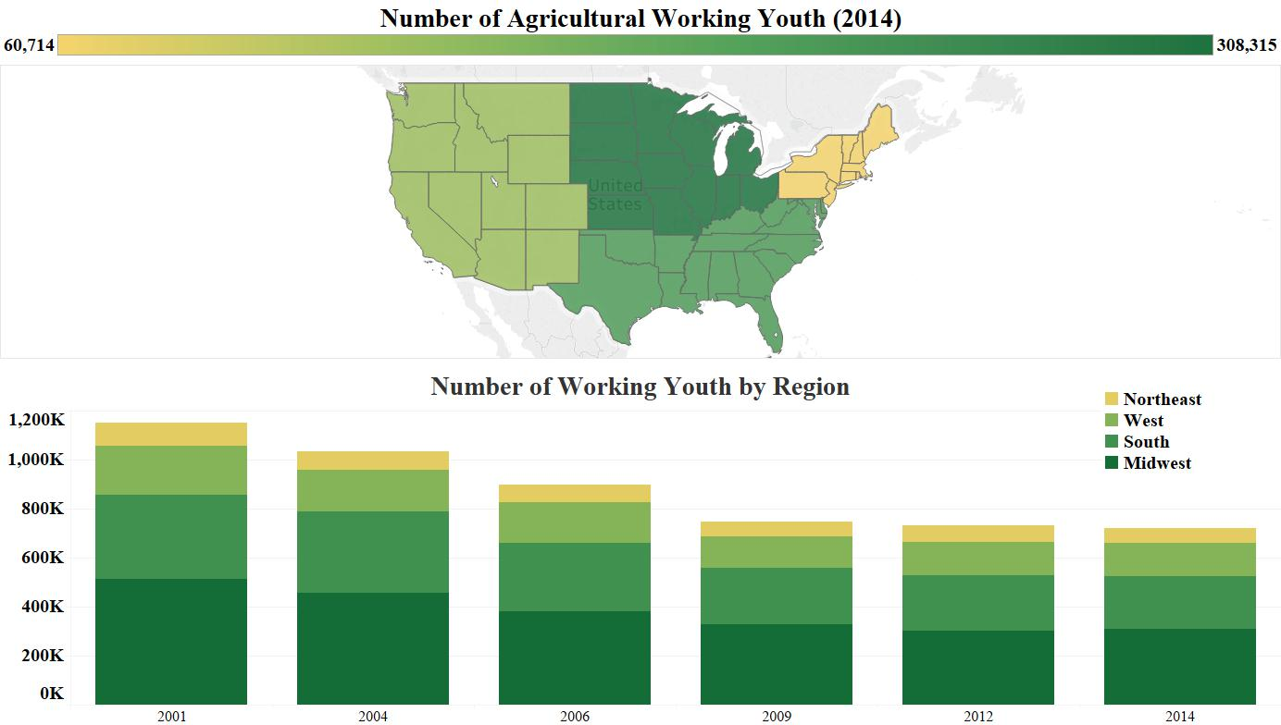
Number of Agriculturally Employed Youth By Region

Slide 8
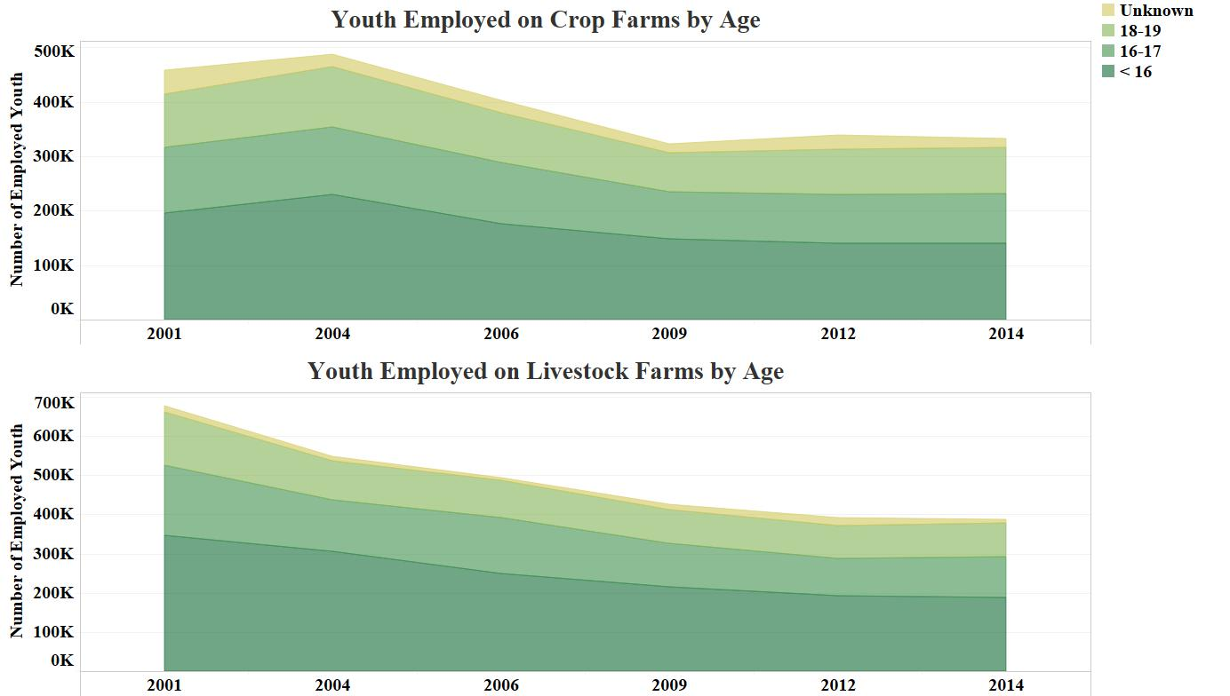
Youth by Age and Farm Type

Slide 9
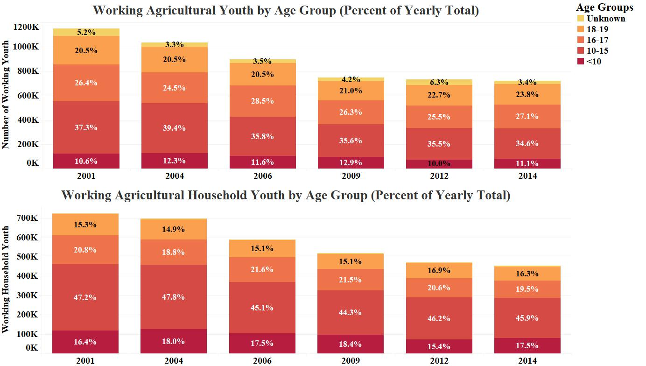
Youth by Age and Type of Worker

Slide 10
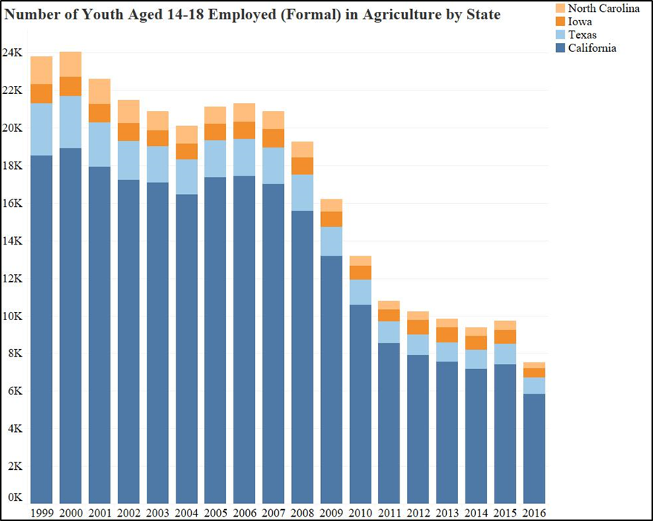
State Totals

Slide 11
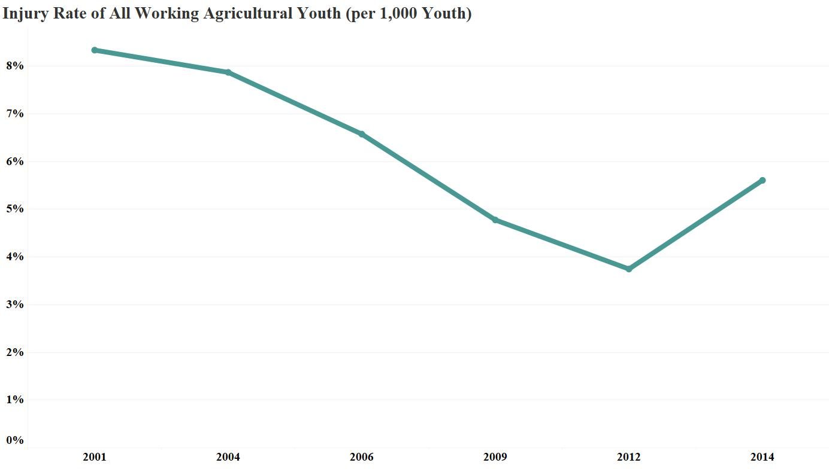
Trends in Injuries

Slide 12
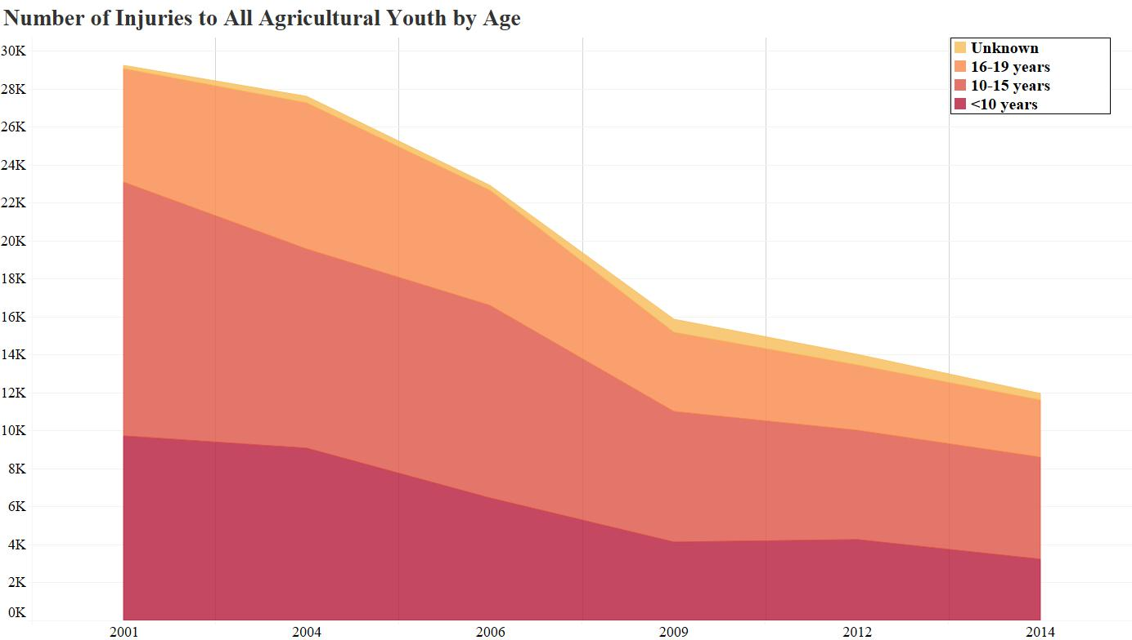
Injuries by Age

Slide 13
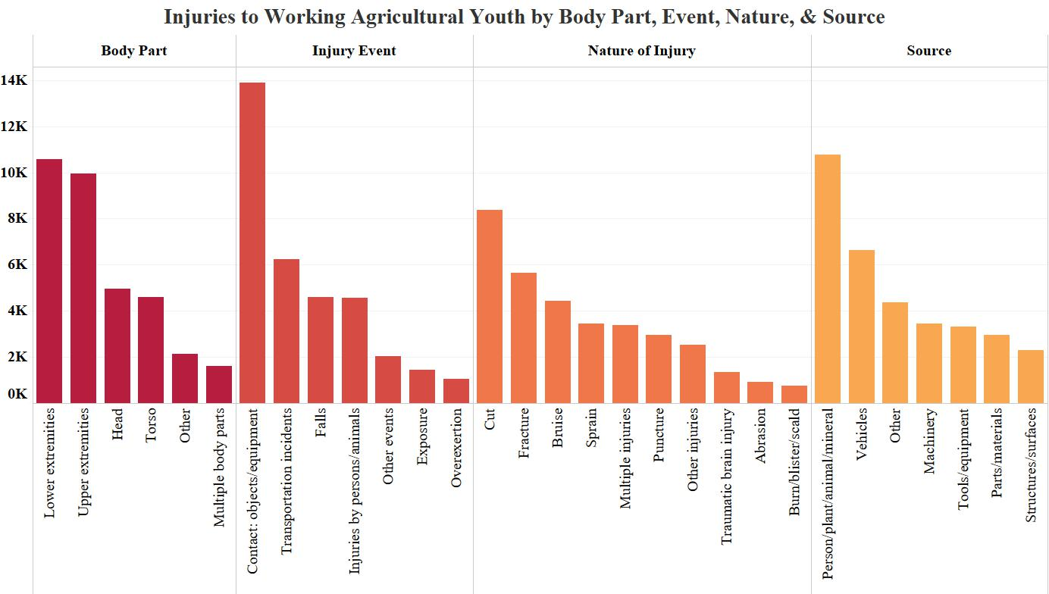
Body Part, Nature, Source, & Injury Event

Slide 14
Summary of Findings
General lack of relevant, detailed data
Federal data largely single source
  NIOSH Child Agricultural Injury Survey (CAIS)
States – almost nothing
Non-governmental – some good qualitative data
Difficulties in data collection
  Rural
  Undocumented workers
  Sensitivity of topic
Main source surveys inconsistent

Slide 15
Data Gaps
Demographic Data
Hazardous Occupations Data
Lack of accurate total
Visitor youth (90%)
Undocumented youth
Specific age groups + [variable]
Race
Educational attainment
States
  State specific data
  Data from the states
Minors on tobacco farms
  Lack of even an accurate total
No data on hazardous occupations
  Injuries as proxy
Data on age of injured youth
Data on type of worker
Data on specific jobs/duties of agriculturally employed youth
Minors on tobacco farms
  No data on health and safety

Slide 16
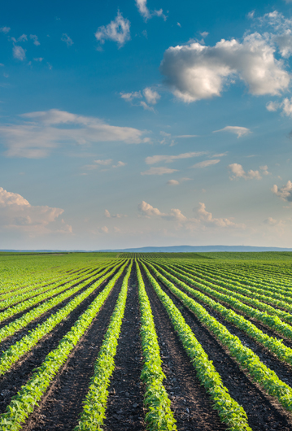
Recommendations
Fill data gaps
Rework the CAIS
  Larger sample
  More detailed questions
  Every 5 years
Amend FLSA
  Bring parity to agricultural and non-agricultural child labor laws/regulations (regardless of availability of data)
Cease approval of regulation that excludes farms with < 10 employees from OSHA’s jurisdiction
Adopt NIOSH’s 2002 recommendations
Rosser, Gregory. 2015. “Field Farm Day.” Mykapuskasingnow.com. http://www.mykapuskasingnow.com/4942/field-farm-day/

Slide 17
Questions

